Slide 1
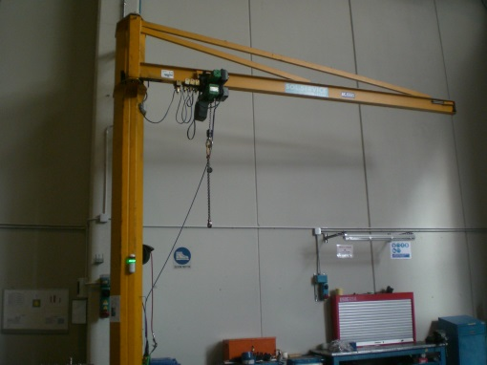
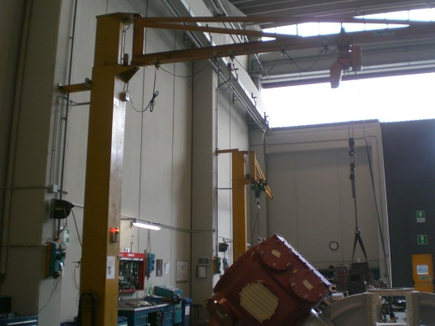
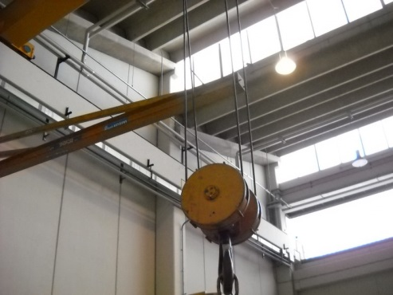
HS&E INCIDENT BULLETIN |  | 1st half year 2014
Location Country | Type of incident (example: Slip-Trip, Fall from Height, Vehicle , Laceration, Chemical Exposure)
Summary:
During activity with crane, the crane hit the end of stroke of crane alongside, that has been broken (near miss)
Root Causes: | Actions Taken Thus Far: Next Steps
Second crane left in dangerous position Possibility of interference between lifting equipment in the same area | Install light signals on the cranes to improve operators’ visibility Issue specific procedure to regulate the safe use of lifting equipment

